Slide 1
DevOps, the database, and the role of the DBA Chris Unwin, Compliant Database DevOps Specialist, Redgate Software
Notes:
Welcome to today’s webinar ‘DevOps, the database, and the role of the DBA ’
First, let’s start with a couple of housekeeping items. All attendees are on mute during the webinar, but we want to hear your questions so if you have any during the course of this presentation, please enter it into your question box and we’ll make sure we leave plenty of time at the end of the webinar to go through them. This webinar is also being recorded and we’ll follow up with a copy of the recording as well as the slides over the next couple of days.

Slide 2


Your Presenter
Chris Unwin
Data Privacy and Protection Specialist
Chris.Unwin@red-gate.com
/in/christopherunwincambridge/
DBAle on Spotify and iTunes
Notes:
[Introduce yourself]
Articles
DBAle
3 years at Redgate

Slide 3
About Redgate
230
2m
18
202,000
Redgaters and counting
years old
customers
SQL Server Central and Simple Talk users
91%
4m
1147
68
of the Fortune 100 use our tools
website visits each year
product releases last year
User Groups sponsored

Slide 4
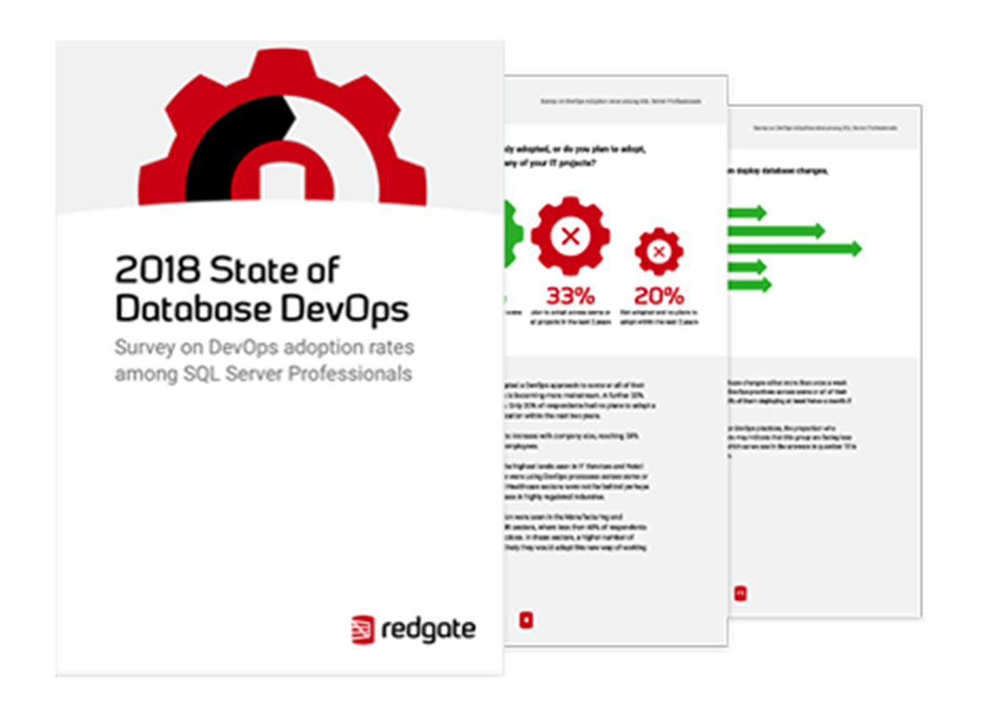
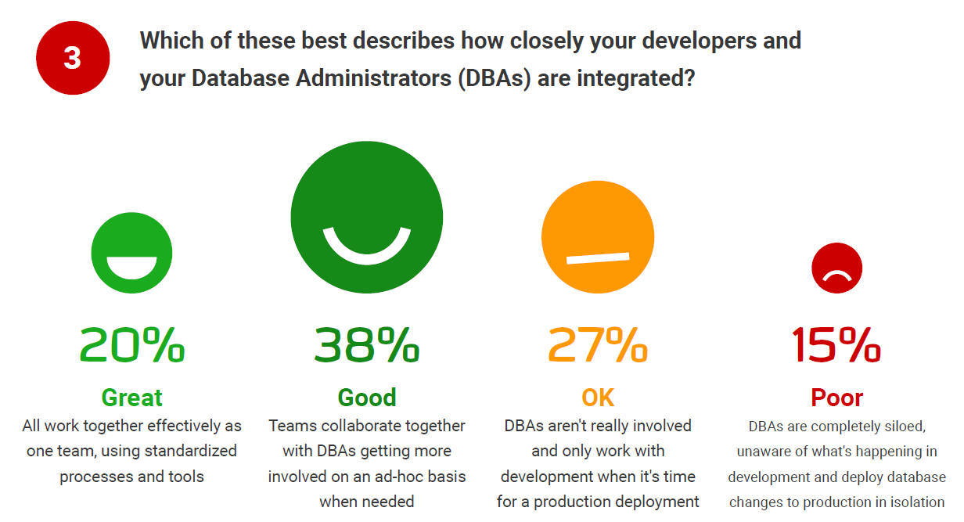
Notes:
You may be familiar with Puppet’s State of DevOps report. We know from the work Puppet and others have done, that there are huge benefits of DevOps – more frequent deployments, faster recovery from failures, improved compliance. But how does this translate to the database? Given that this is our area of expertise and that we believe these benefits can be significantly increased by aligning your database development with your application, Redgate has, for the past few years, done a State of Database DevOps report.
In order to get your application and database development processes more aligned, your dev and DBAs are going to have to work collaboratively as an integrated team. Let’s run a quick poll and see what those of you on the call think.
*** RUN POLL*** How integrated are you (the DBA) with you’re developers?
Great – we work together effectively as one team
Good – we collaborate together and are usually involved on an adhoc basis
OK – we only work together when it’s time for a production deployment
Poor – we’re unaware of what’s happening in dev and deploy database changes in isolation
In our State of Database DevOps report the majority of respondents reported that their development team and DBAs are well integrated, with 58% answering either ‘good’ or ‘great’ to the question about levels of collaboration.
This figure went up to 68% among those who had already adopted a DevOps approach to some or all of their projects. But with 11% of these groups reporting poor integration, and 22% saying DBAs are only involved when it came to deployment, it seems some teams still have a way to go before the database is fully embraced as part of the DevOps pipeline.
It’s interesting to look at this information in relation to company size: there’s a clear correlation showing that the larger the company, the less integrated developers are with DBAs, with 65% of companies with under 500 employees reporting ‘good’ or ‘great’ integration compared to just 48% of companies with over 500 employees.
The other thing that’s interesting is how these stats have changed over the past year. Last year, the number of people who said DBAs were completely siloed was higher.
***COMMENT ON POLL RESULTS***

Slide 5
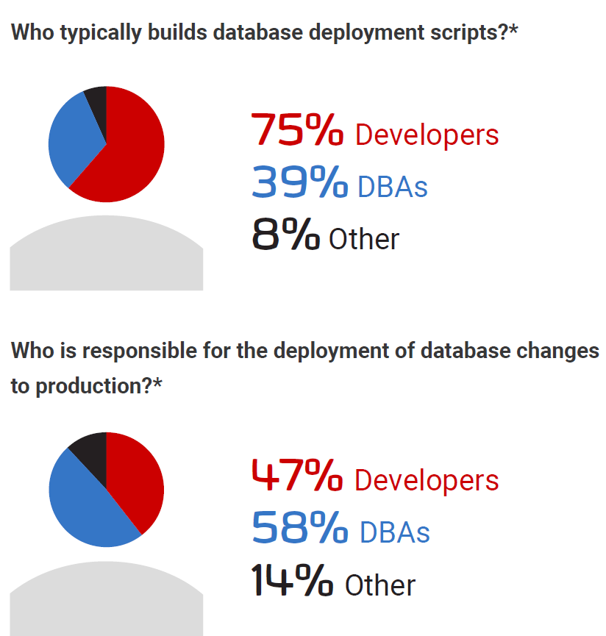
Notes:
When it comes to the building of database deployment scripts, overall the large majority are built by developers with DBAs contributing to deployment script building in just 39% of organizations.
Interestingly, compared to last year, there are more organizations where this work is shared across developers and DBAs.
Looking at who is responsible for deploying the scripts to production, developers are now handling deployments to production in almost half of organizations – a 20% increase from last year.

Slide 6
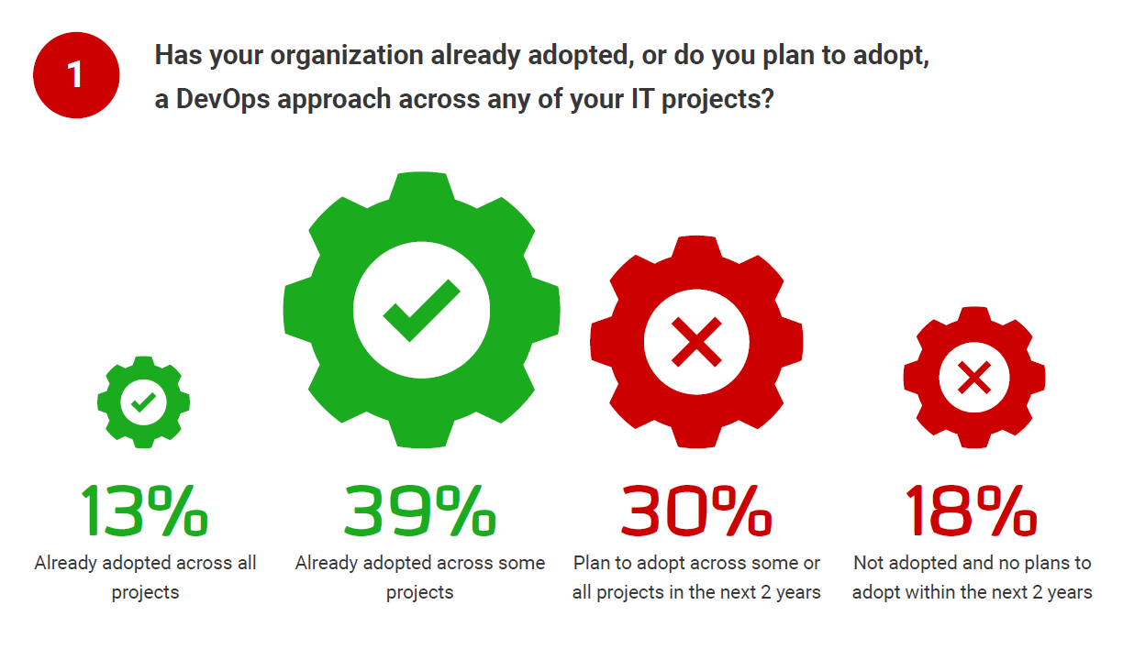
Notes:
You can see here, that over half of people we asked are already adopting DevOps across all or some of their projects. This is a 10% increase from last year, and a clear demonstration that DevOps is firmly established in the mainstream. A further 30% plan to adopt during the next two years, leaving just 18% of respondents having no current plans to adopt a DevOps approach within their organization within the next two years.
I’m assuming based on your attendance to today’s webinar that you’re already adopting or have plans to adopt DevOps in your organization. But where does the database fit into these plans?

Slide 7
But what about the database?
Why it’s hard to include the database…
Business-critical data needs to be protected
Databases carry state
And why you should do it anyway
Database and application development needs to be aligned
Ability to roll back previous versions
Manual processes require a lot of Dev and DBA hours
Record of database changes for audit trail
Notes:
A lot of companies I work with have a really clear distinction between the database and the application. When we speak to them, they are extremely proud of the work they’ve done for the application, rightly so, but when I ask them about their process for database changes alongside the application, the conversation often changes to one where application releases are happening weekly, daily, hourly, while database changes are being deployed sometimes monthly.
This was clear in our State of Database DevOps report too. When we explored DevOps practices like version control, continuous integration and automated deployment, there’s a huge gap between the techniques IT teams are using for the application vs what’s being put in place for the database. In fact, in many cases, the application practices were twice the size of the database!
But the database shouldn’t and doesn’t have to be the bottleneck to your DevOps success.
Yes the database can be a little bit harder to handle – databases contain data, and that information needs to be safely manipulated and the content needs to be correctly preserved – with most applications, you can pretty much throw away the old version and put a new one in it’s place. And traditionally, there has been a lot more tooling available for DevOps for the application, tools for version controlling the database for example is a relatively new thing in comparison to the application.
But, it’s something we need to push through and make sure the pace of database development is synchronized with the application team. It’s unacceptable for database changes to be delaying the delivery of value to users. And no doubt, you as the DBA is feeling the pressure of this – not only from the number of requests you’re getting, but the time it takes to deal with these actions. We know that manual processes require a lot of Dev and DBA hours and one of the key reasons for extending DevOps practices to the database, is the ability to reduce the number of manual processes, giving you much more time to focus on value added projects. In addition to this, with increasing regulations like GDPR, HIPPA and SOX, it’s becoming more and more important to create an audit trail of database changes.

Slide 8
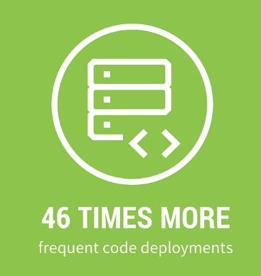
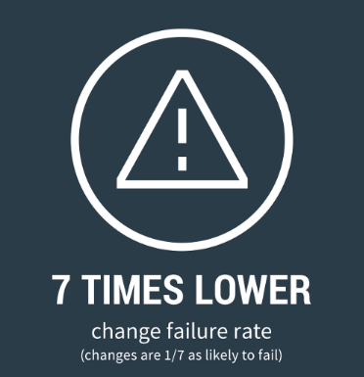
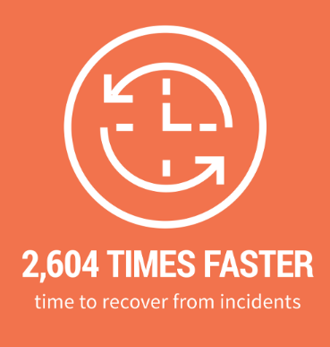
2018 Accelerate: State of DevOps Report
Notes:
Now in its fifth year, DORA’s 2018 Accelerate State of DevOps Report is a key part of the landscape of DevOps content and conversations.
In this year’s report they calls out database development as a key technical practice which can drive high performance in DevOps. The report directly states that “database changes are often a major source of risk and delay when performing deployments”.
The research data shows that the highest-performing organizations which adopt DevOps release changes 46 times more frequently.
They have a change failure rate that is 7 times lower,
And they are able to recover from breaking changes 2,604 times faster.
In addition, 87% of respondents said they were subject to requirements related to regulatory compliance. However, Infosec teams are often relatively poorly staffed when compared to their technical peers. The survey cites
a ratio of one Infosec person per 10 infrastructure people per 100 developers in large companies.

Slide 9
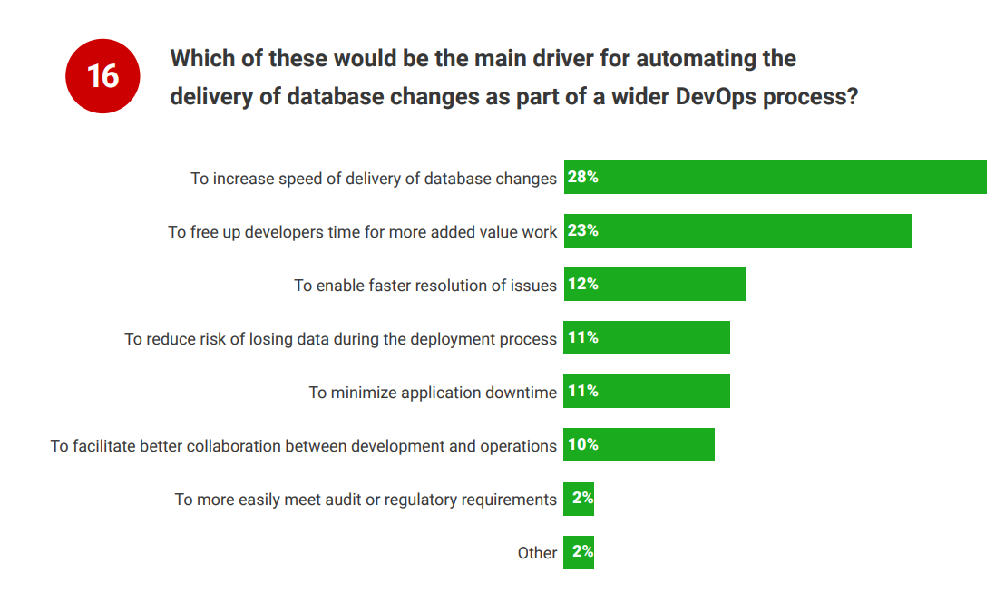
Notes:
Continuing on from the research conducted by DORA, we know that there are huge benefits of DevOps – more frequent deployments, faster recovery from failures, improved compliance. But how does this translate to the database? Given that this is our area of expertise and that we believe these benefits can be significantly increased by aligning your database development with your application, Redgate has, for the past few years, done our own State of Database DevOps research.
In the survey, we asked people what the key driver was for extending DevOps practices to the database. The top responses were to increase the speed of delivery and free up developers time for more value added work.
This aligns really nicely with the need to innovate at speed …..

Slide 10
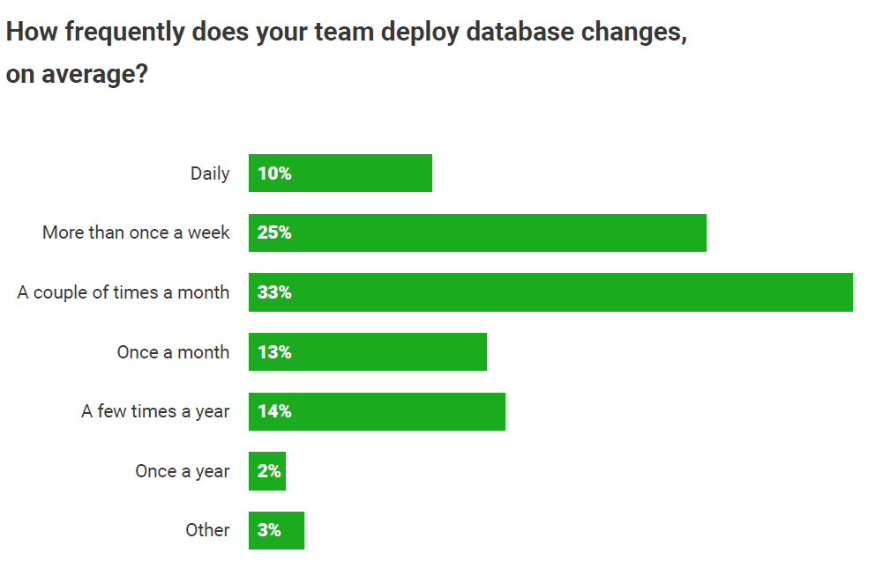
Notes:
25% of respondents are deploying database changes either more than once a week or daily. In the group who had adopted DevOps practices across some or all of their projects, this figure rose to 38%, with 73% of them deploying at least twice a month, if not more.
Among those who had no plans to adopt DevOps practices, the proportion who release at least twice a month was only 54%. This may indicate that this group are facing less pressure to shorten the release cycle. Increasing the speed of delivery of database changes was the number 1 driver for automating the delivery of database changes as part of a wider DevOps process.

Slide 11
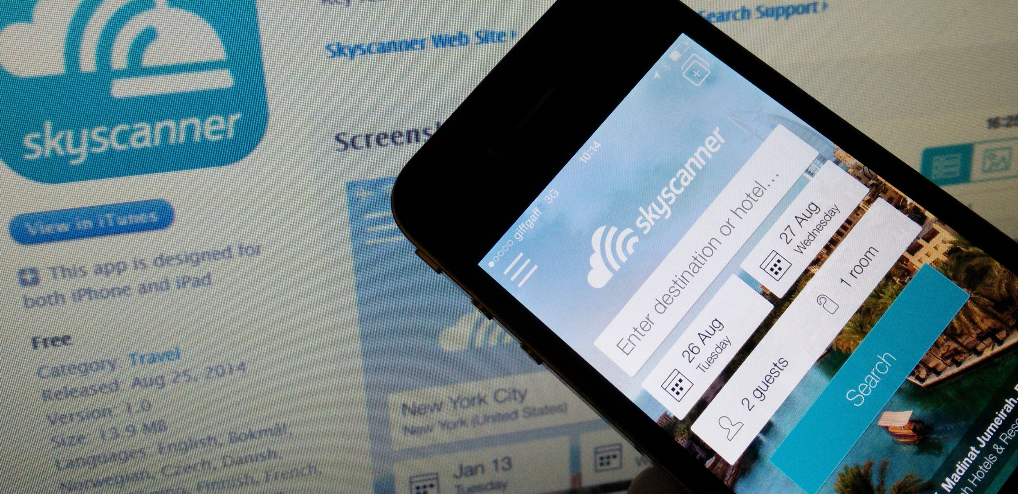
“We’re managing to release up to 95 times a day. It’s vastly improved over one release every six weeks.”
Ryan Crawford, Technical Manager, Skyscanner
Notes:
In fact, this is something that Skyscanner has found since the adoption of Database DevOps. For those who aren’t familiar with Skyscanner, it’s a leading global travel search site, headquartered in the UK. Its journey from three founders with a spreadsheet to a team of 800 people managing the world’s largest travel search engine, is a fascinating one.
They now average around 50 million unique customer visitors across their mobile and web applications and so maintaining and updating the data and infrastructure behind that is a huge task.
But, by adopting practices like continuous integration, they are now releasing database changes 95 times a day, rather than once every 6 weeks. This isn’t a unique case. Companies all over the world are under pressure to release at this sort of speed, but the demand this places on database administrators, are greater than they ever have been before.
So what does this mean for you as the DBA? Well, a lot more requests, a lot more frequently and you probably notice you’re having to say ‘no’ more often because you don’t have the time to deal with the volume of demands and you need to ensure that data is preserved and safeguarded – even more so with the likes of GDPR and the high volume of data breaches taking place.
What I’m going to share with you today is some of the techniques you can adopt to make sure you strike the balance between minimizing the risk of failed deployments, protecting business critical data, and keeping up with releases from the rest of the business which are pushing to production daily, or like Skyscanner, even hourly.

Slide 12
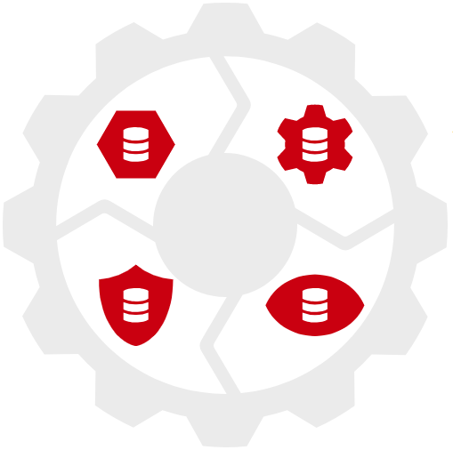




4 Elements of Compliant Database DevOps
Notes:
So what can you do to ensure that your database development process is secure & compliant?
At Redgate, we would recommend you start by looking at these 4 areas, to start your journey to Compliant database DevOps processes.

Slide 13
A complete database DevOps process
Notes:
This is Regdate’s preferred Database DevOps process and a similar toolchain to the one being adopted at the likes of Skyscanner, as well as Barclays Bank, Fitness First, Yorkshire Water and Merrill Lynch. What you’ll see along the top is the traditional application deployment pipeline, starting from the left where we have developers making changes and committing them into source control etc.
At Redgate, we believe that the same principles should be applied to databases without having to change much of what you’re already doing with the application code – so we believe that the same techniques and steps should be taken but of course with the addition of the database and the DBAs.
While we recognize the importance of the DBA throughout the entire process, we’re going to focus on 2 key areas in today’s webinar which align with your priorities – provisioning and monitoring.
Before we dig into those in a bit more detail, I thought I’d quickly touch on two important aspects of this diagram – source control and automated deployments/releases.
**Talk a little bit about the benefits of version control and automation from a DBA perspective – streamline development and deployments and ensure quality and security throughout, , automate deployments and free up time to focus on value added work

Slide 14
Question and Answer Session

